Slide 1
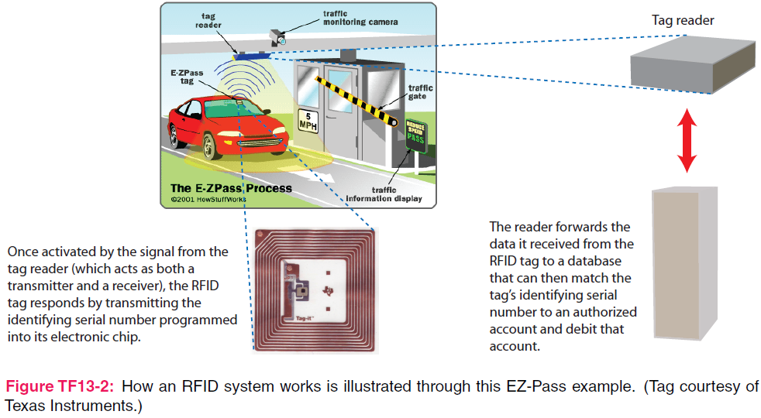
7. Plane Wave Propagation
7e Applied EM by Ulaby and Ravaioli

Slide 2
Chapter 7 Overview

Slide 3
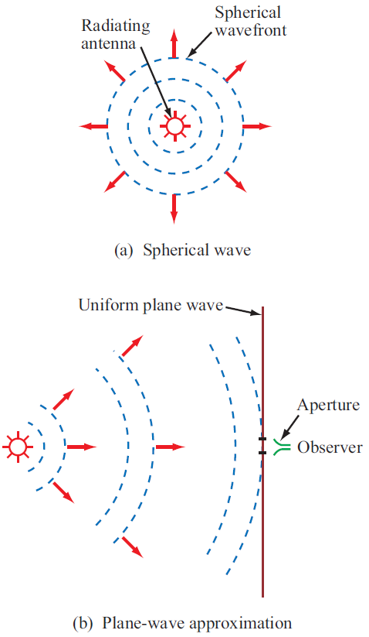
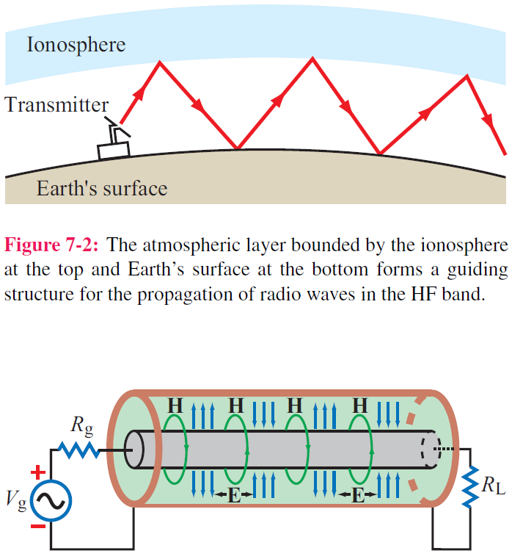
Guided EM Waves
Unbounded EM Waves

Slide 4
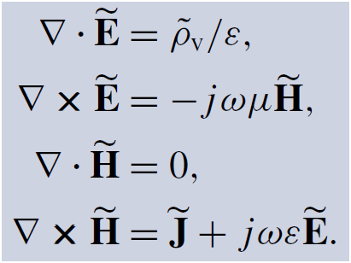
Time-Harmonic Fields
For sinusoidal time variations:
For a linear, isotropic, and homogeneous medium with ε and μ, the Maxwell’s equations in phasor form are

Slide 5
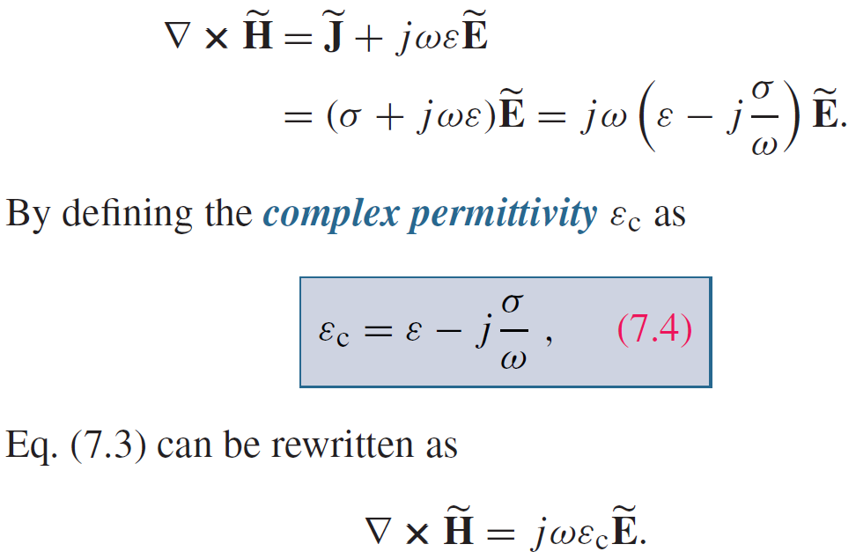
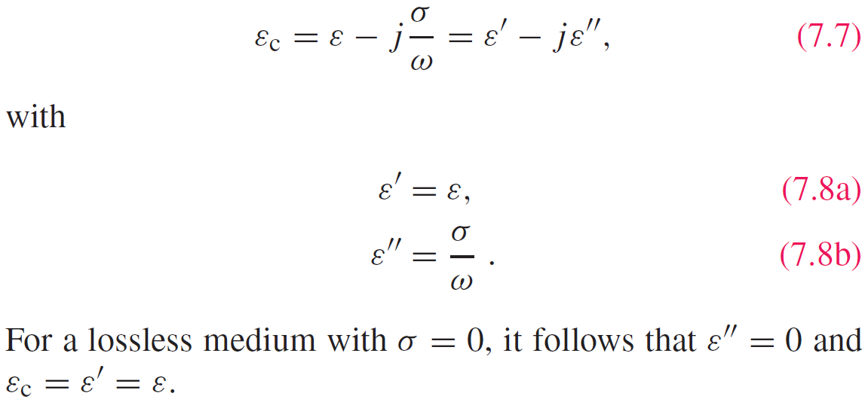
Complex Permittivity

Slide 6
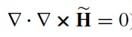
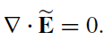
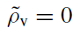
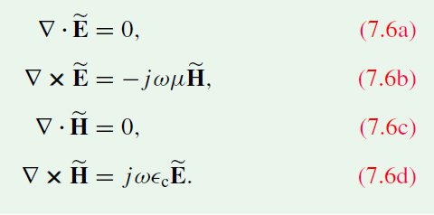
Complex Permittivity
The divergence of the curl of any vector field is zero, requires
Then, the Maxwell’s equations become

Slide 7
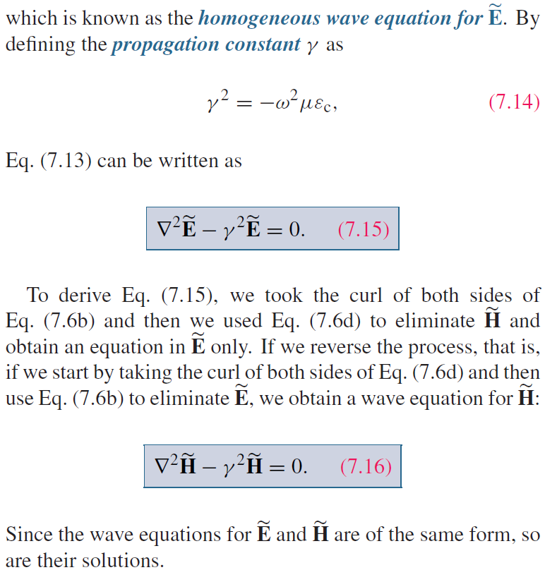
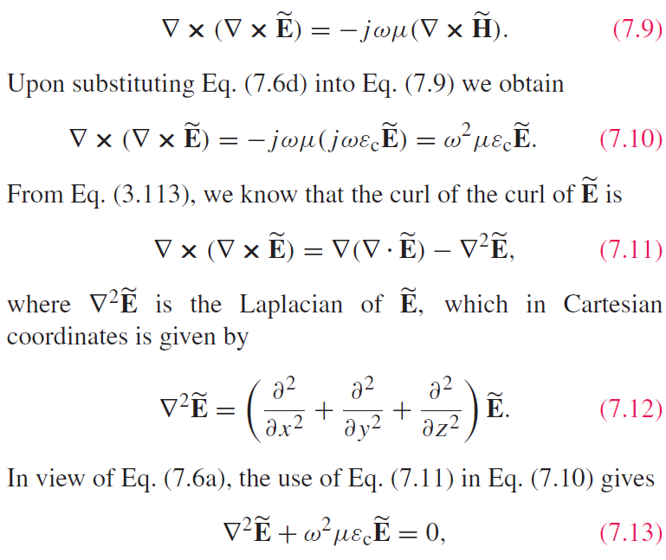
Wave Equations
Helmholtz equation

Slide 8
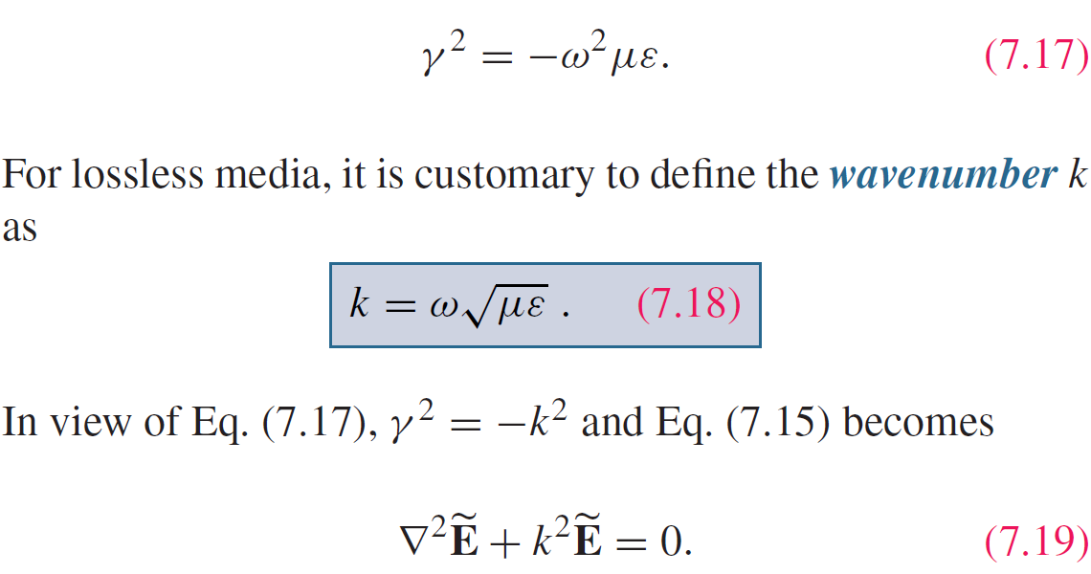
Lossless Media
If the medium is nonconducting (σ = 0), the wave does not suffer any attenuation as it travels and hence the medium is said to be lossless.

Slide 9
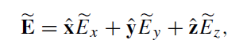
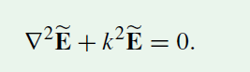
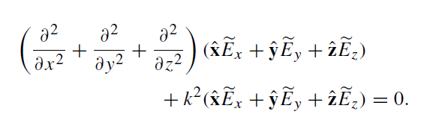
Uniform Plane Wave

Slide 10
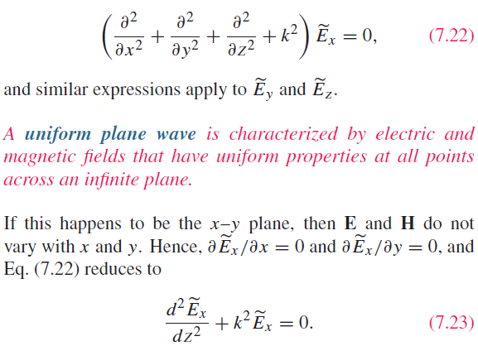
Uniform Plane Wave

Slide 11
Transverse Electromagnetic (TEM) Wave

Slide 12
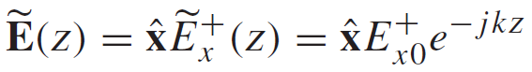
Uniform Plane Wave Solution
-z propagation
General Form of the Solution:
+z propagation
For a wave travelling along +z only:

Slide 13
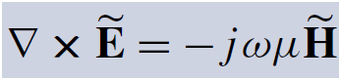
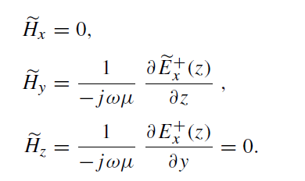
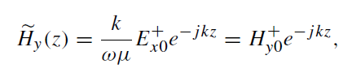
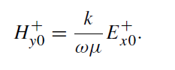
Uniform Plane Wave Solution
The corresponding M field is obtained by

Slide 14
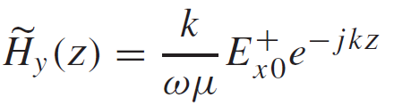
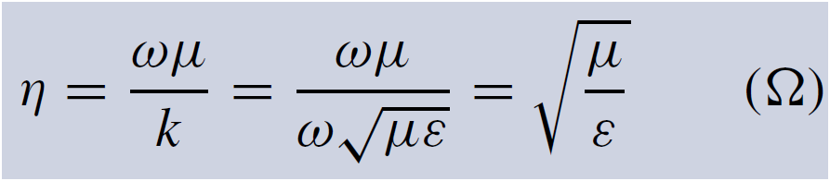
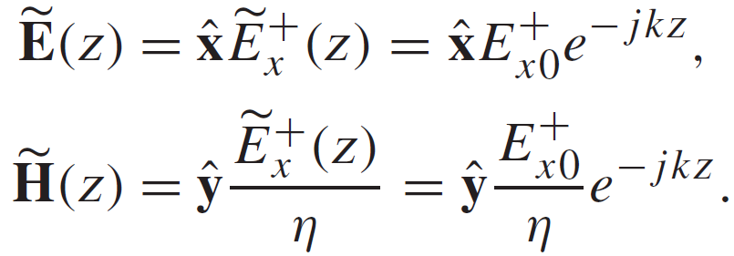
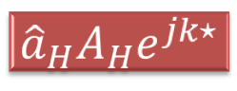
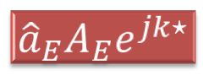
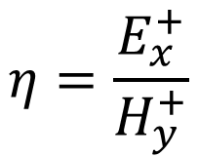
Intrinsic Impedance
$$η=\frac{E_{x}^{+}}{H_{y}^{+}}$$
Intrinsic impedance of the medium or wave impedance
Summary: This is a plane wave with
$${\hat{a}}_{E}A_{E}e^{jk⋆}$$
Exponential term for propagation
Direction
Amplitude
$${\hat{a}}_{H}A_{H}e^{jk⋆}$$

Slide 15
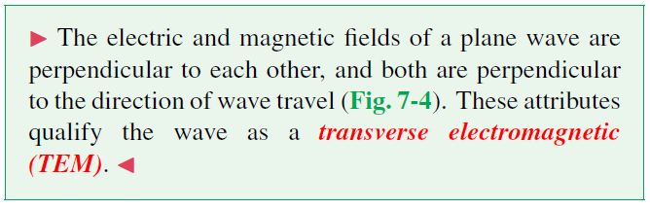
TEM wave

Slide 16
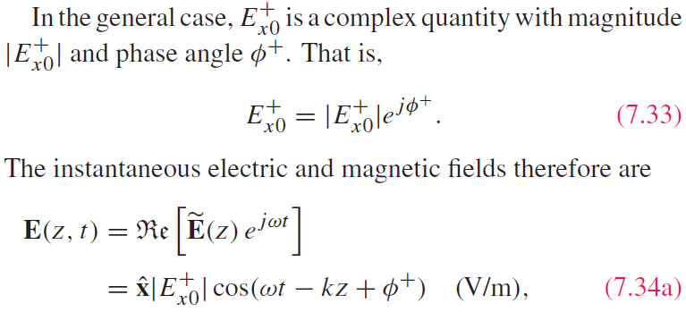
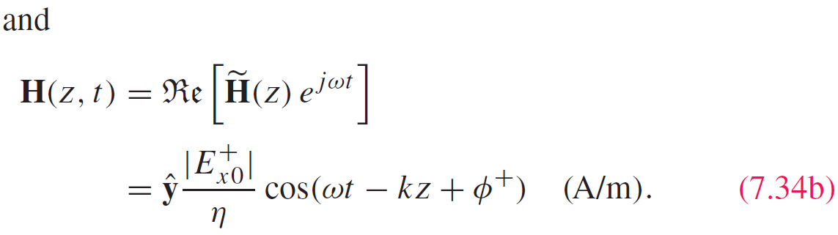
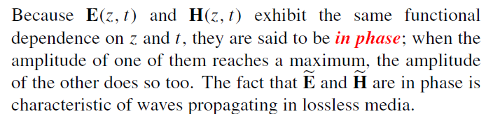
Time-Domain Solution

Slide 17
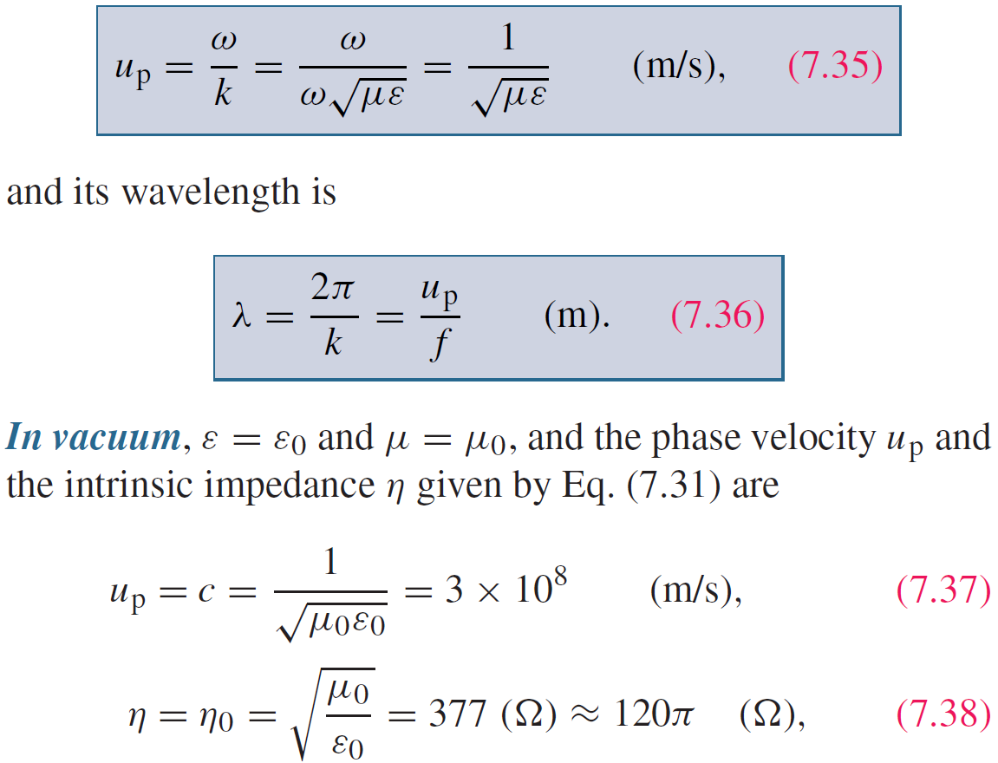
Wave’s Phase Velocity

Slide 18
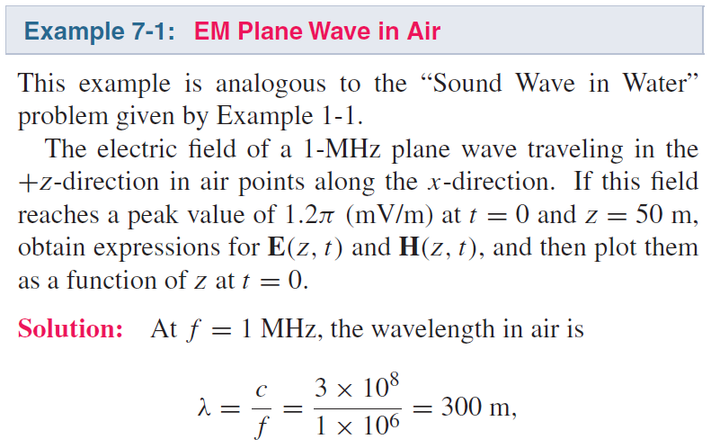
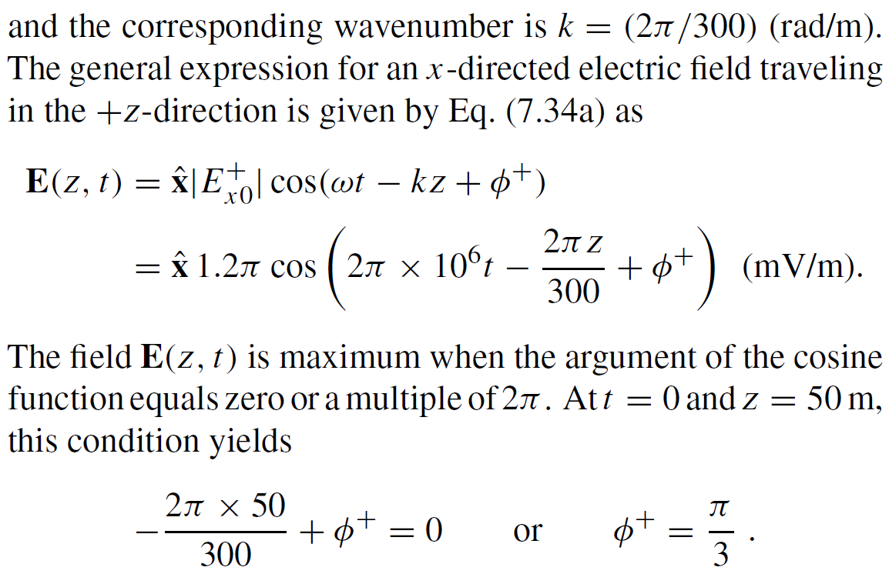
Cont.

Slide 19
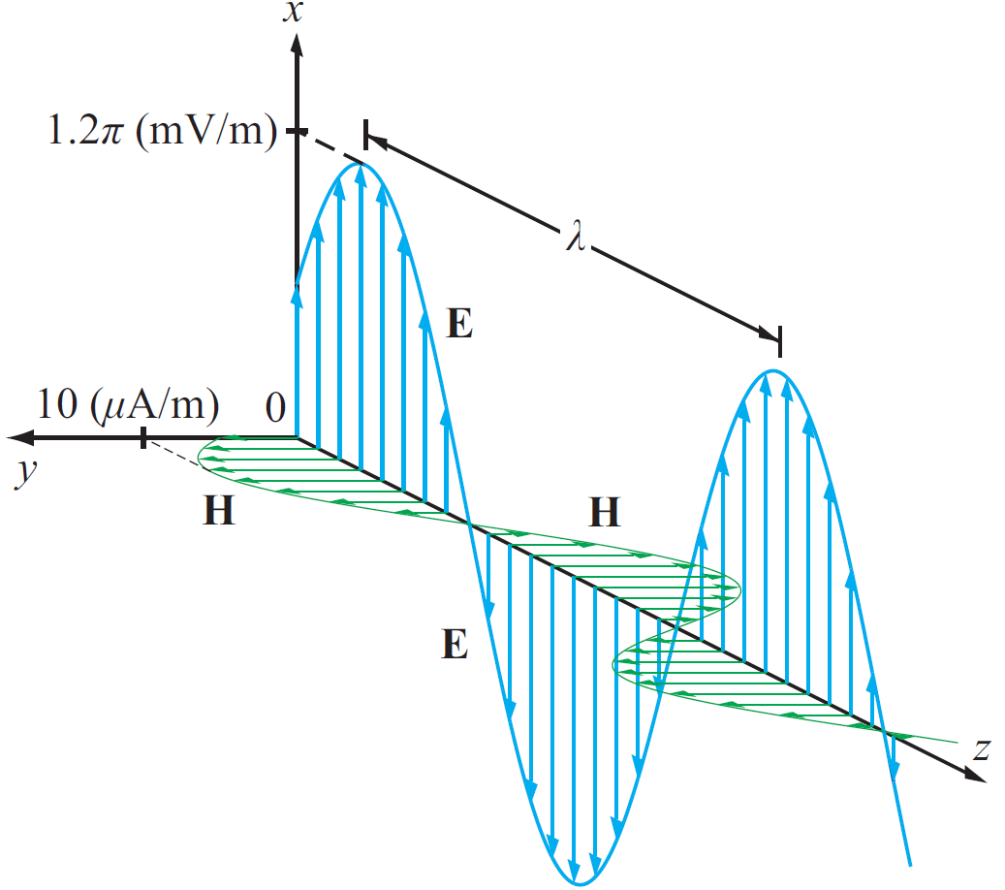
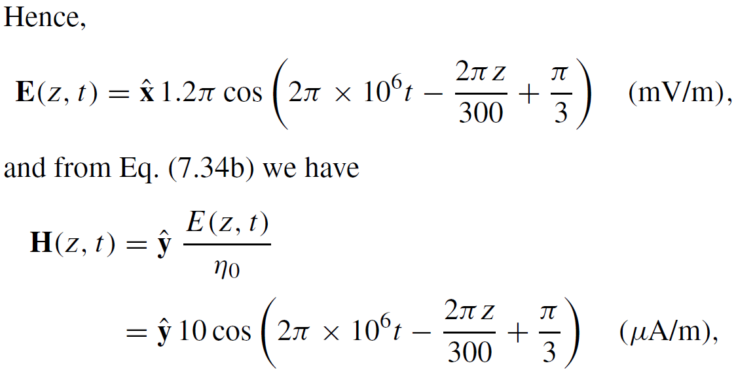
Example 7-1 cont.

Slide 20
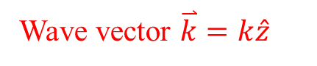
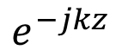
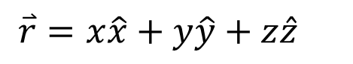
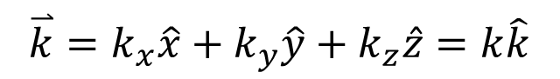
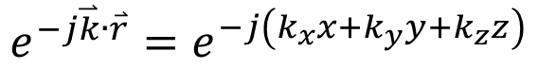
General Plane Wave
+z propagation
$$e^{−jkz}$$
Wave vector $\overset{⃑}{k}=k\hat{z}$
General-direction propagation
$$e^{−j\overset{⃑}{k}∙\overset{⃑}{r}}=e^{−j\left(k_{x}x+k_{y}y+k_{z}z\right)}$$
$$\overset{⃑}{k}=k_{x}\hat{x}+k_{y}\hat{y}+k_{z}\hat{z}=k\hat{k}$$
$$\overset{⃑}{r}=x\hat{x}+y\hat{y}+z\hat{z}$$
General plane wave
$$\overset{⃑}{E}={\overset{⃑}{E}}_{0}e^{−j\overset{⃑}{k}∙\overset{⃑}{r}}=\left(E0x\hat{x}+E0y\hat{y}+E0z\hat{z}\right)e^{−j\overset{⃑}{k}∙\overset{⃑}{r}}$$

Slide 21
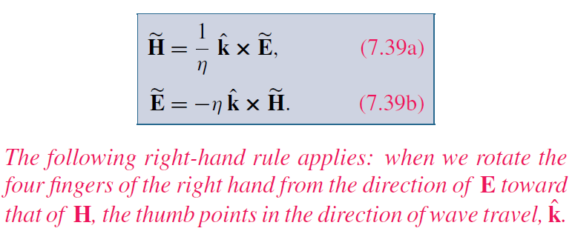
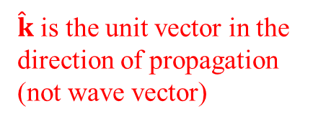
Cont.
For Any TEM Wave
$\hat{k}$ is the unit vector in the direction of propagation (not wave vector)

Slide 22
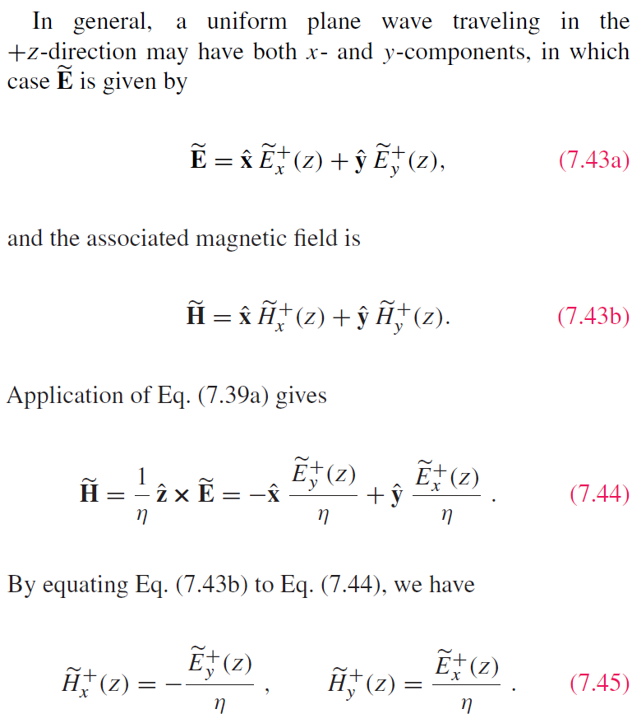
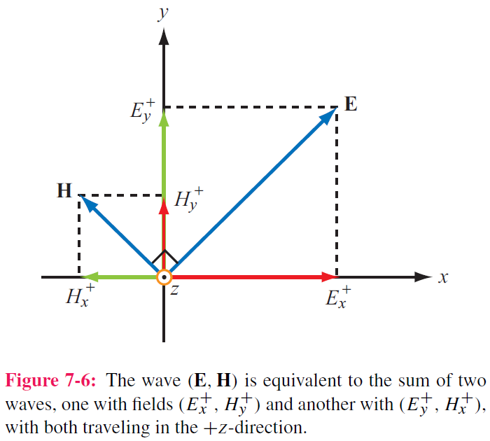
Wave decomposition

Slide 23
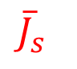
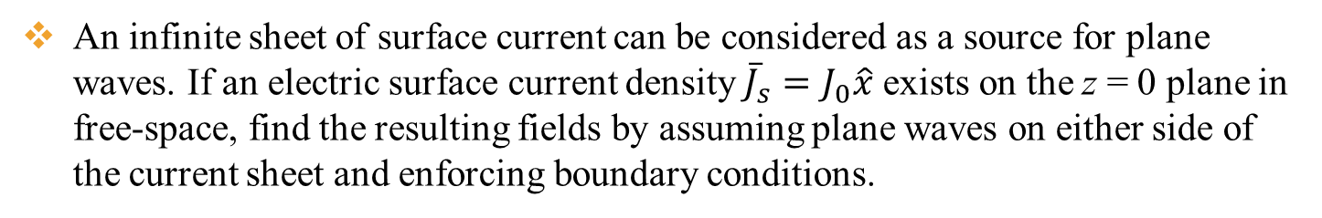
Example
An infinite sheet of surface current can be considered as a source for plane waves. If an electric surface current density ${\overline{J}}_{s}=J_{0}\hat{x}$ exists on the z = 0 plane in free-space, find the resulting fields by assuming plane waves on either side of the current sheet and enforcing boundary conditions.
x
E must be in -x direction
$${\overline{J}}_{s}$$
H must be in -y direction for z propagation, and +y direction for –z propagation
Then the fields can be written in the following form with A (<0) and B (<0) are arbitrary numbers representing field amplitudes in the z < 0 and z > 0 region
z
y

Slide 24
Cont.
The boundary conditions at z = 0 are
E_{1x}=E_{2x}
With the first boundary condition at z = 0 (E_{x} continuous), we get A = B
Use the second boundary condition at z = 0, we get B + A = -J₀ So A = B = -J₀ /2

Slide 25
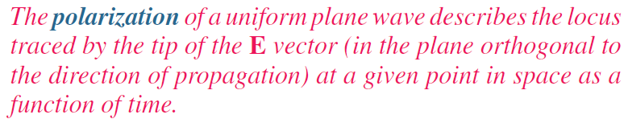
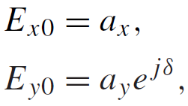



Wave Polarization
Phase difference
If:
Plane wave propagating along +z :
then
$$a_{x}≥0 a_{y}≥0$$
Generally complex numbers

Slide 26


Polarization State
Polarization state describes the trace of E as a function of time
at a fixed z
Magnitude （not amplitude） of E
Inclination Angle

Slide 27



Linear Polarization:
or
E traces a line( in blue) as the wave traverses a fixed plane
Special cases

Slide 28




Circular Polarization
Polarization Handedness
Left-hand
Right-hand

Slide 29


LH Circular Polarization:
y component is 90° ahead of x component
phase of x component needs to take T/4 to become the current phase of y component
Constant magnitude

Slide 30

RH Circular Polarization:
x component is 90° ahead of y component

Slide 31



Cont.

Slide 32
Example 7-2 cont.
Wave with electric field magnitude
of 3 (mV/m) traveling in the +y-direction
Cont.

Slide 33
Example 7-2 cont.

Slide 34




Elliptical Polarization: General Case
Linear and circular polarizations are special cases of elliptical polarization

Slide 35

Cont.

Slide 36


Example 7-3 cont.

Slide 37


Lossy Media
Lossless
Cont.

Slide 38

Lossy Media
Both are positive
Check when ε” = 0

Slide 39

Attenuation
E and H fields:
+z propagation
Cont.

Slide 40


Attenuation
Magnitude of E
Skin depth

Slide 41

Low and High Frequency Approximations

Slide 42

Example 7-4: Plane Wave in Seawater
Cont.

Slide 43

Example 7-4: Plane Wave in Seawater
Cont.

Slide 44
Example 7-4: Plane Wave in Seawater
Cont.

Slide 45
Example 7-4: Plane Wave in Seawater
Cont.

Slide 46
Example 7-4: Plane Wave in Seawater

Slide 48




Power Density
Poynting vector:
Total power intercepted by A:
Time-average power density:

Slide 49



Plane Wave in Lossless Medium
For a plane wave with E H field :
the time-average power density carried by the wave is:

Slide 50





Plane Wave in Lossy Medium
For a plane wave travelling in a lossy medium:
the power density is :

Slide 51




Slide 52






Power Density of Different Polarization
$$\overset{⃑}{H}=\hat{y}\frac{E_{0}}{η_{0}}e^{−jkz}$$
Linear Polarization
$$\overset{⃑}{E}=\hat{x}E_{0}e^{−jkz}$$
$${\overset{⃑}{S}}_{av}=\frac{1}{2}Re\left[\overset{⃑}{E}×{\overset{⃑}{H}}^{∗}\right]=\hat{z}\frac{E_{0}^{2}}{2η_{0}}$$
Circular Polarization
$$\overset{⃑}{H}=\frac{E_{0}}{η_{0}}\left(\hat{y}−j\hat{x}\right)e^{−jkz}$$
$$\overset{⃑}{E}=E_{0}\left(\hat{x}+j\hat{y}\right)e^{−jkz}$$
$${\overset{⃑}{S}}_{av}=\frac{1}{2}Re\left[\overset{⃑}{E}×{\overset{⃑}{H}}^{∗}\right]=\frac{E_{0}^{2}}{2η_{0}}Re\left[\left(\hat{x}+j\hat{y}\right)e^{−jkz}×\left(\hat{y}+j\hat{x}\right)e^{jkz}\right]$$
$$=\frac{E_{0}^{2}}{2η_{0}}Re\left[\left(\hat{x}+j\hat{y}\right)×\left(\hat{y}+j\hat{x}\right)\right]=\frac{E_{0}^{2}}{2η_{0}}Re\left[\hat{z}+\hat{z}\right]=\hat{z}\frac{E_{0}^{2}}{η_{0}}$$
Total fields

Slide 53

Summary
Homework due XXX

